Slide 1
CAT: Closed-Loop Adversarial Training for Safe End-to-End Driving
Industry Mentor:
Dr. Parvej Khan
SimDaaS Autonomy Pvt. Ltd.
Internal Faculty Mentor:
Dr. Sakshi Indolia
School of Technology Management & Engineering
NMIMS, Navi Mumbai

Slide 2
Table of Content
Problem Statement
Introduction of Organisation
Exploratory data analysis
Methodology
Learning outcome
Future work
3/11/2025
Digital Logic Design

Slide 3
Introduction of organization
SimDaaS Pvt Ltd. is a technology-driven company specializing in simulation solutions for autonomous systems. It enables businesses to accelerate development, improve safety, and reduce time-to-market for autonomous technologies across industries such as transportation and logistics.
Technologies Used
Physics-Based Modelling: Realistic sensor & environment simulation
Learning-Based Techniques: AI-powered scenario generation
Customization & Scalability: Tailored to client needs, built for scale

Slide 4
Introduction of organization
Core Competencies:
1. Data Simulation
High-fidelity LiDAR & camera outputs
Ideal for training perception and sensor fusion models
2. Scenario Simulation
Diverse, dynamic, and region-specific traffic scenarios
Crucial for testing planning and decision-making algorithms
3. Traffic Simulation
Real-world traffic pattern generation
Supports ADAS and AV system evaluation.

Slide 5
Problem Statement
Definition: Adversarial training framework for Autonomous vehicles safety.
Objectives: The focus is on developing an agent capable of driving autonomously in a simulated environment, MetaDrive, which presents various realistic driving scenarios.
It is achieved using RL strategies like PPO and TD3.

Slide 6
Tools and Technologies
MetaDrive Simulator (version: 0.4.3)
Google Colab
Reinforcement Learning (PPO & TD3)
Waymo open dataset.

Slide 7
Exploratory data analysis
Waymo Open Dataset – Overview
Developed by Waymo, a leader in autonomous driving.
Provides high-quality, real-world sensor data from self-driving vehicles.
Rich sensor suite: Lidar + Camera Data, Covers urban, suburban, and highway settings.
Enables robust training & evaluation of AV models.
Includes annotations: vehicles, pedestrians, cyclists.

Slide 8
Exploratory data analysis
Waymo Open Dataset – Structure
Organised into segments (short continuous driving episodes).
Stored in TFRecord format (optimized for TensorFlow workflows).
Each segment contains:
Sensor streams (lidar point clouds, images)
Bounding box annotations and object trajectories
Scenario metadata (location, time, weather)

Slide 9
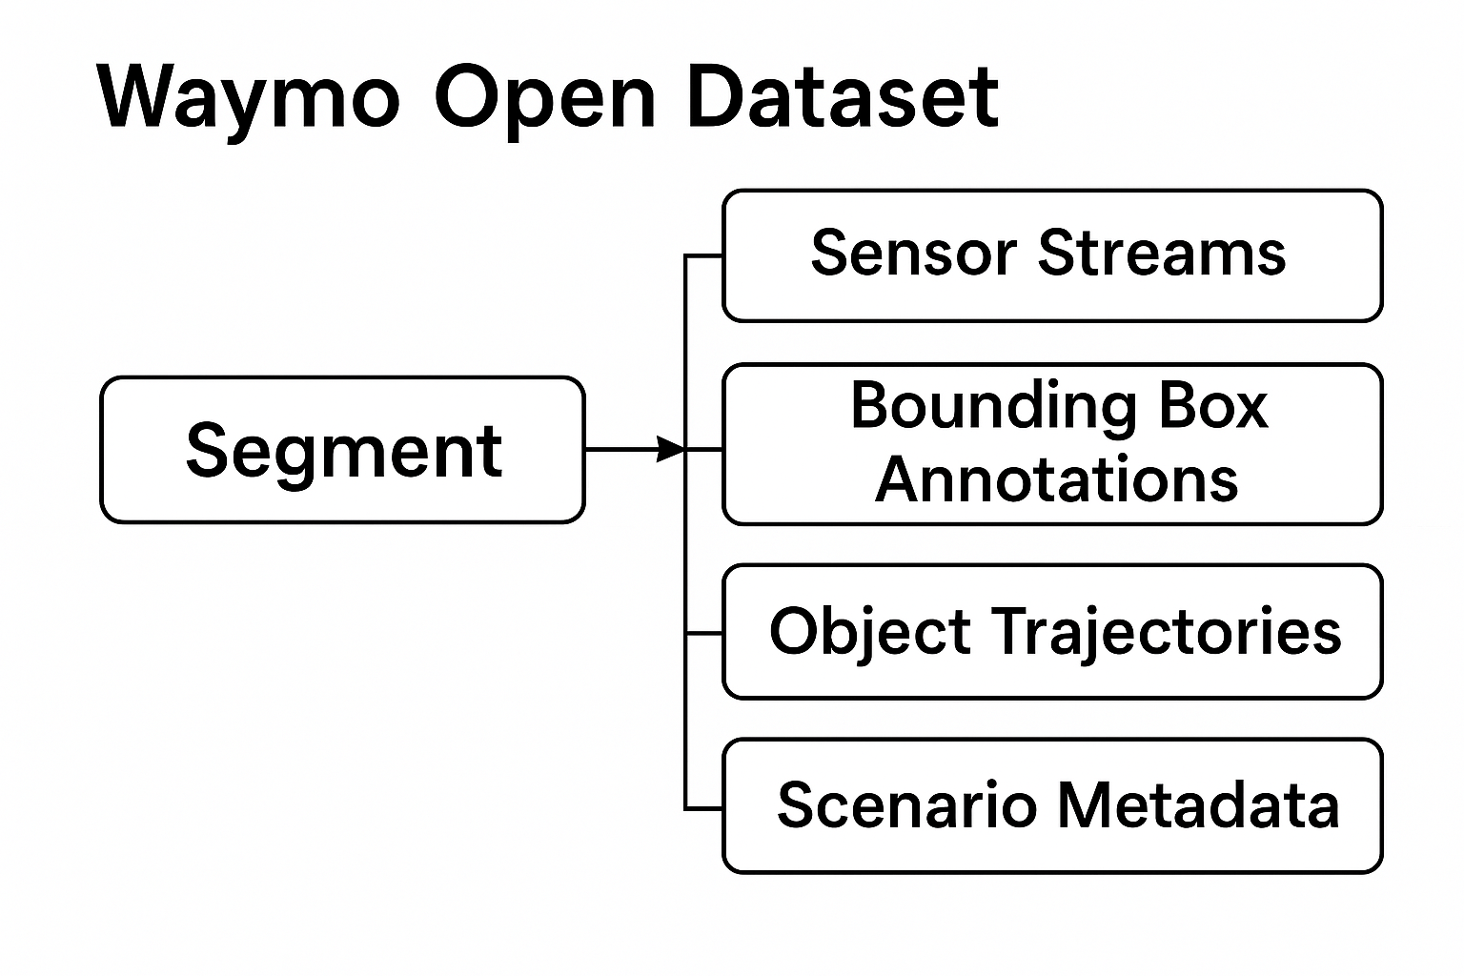

Slide 10
Methodology
Setting up the MetaDrive environment with different configurations.
Implementing a TD3 reinforcement learning agent with a replay buffer
Training the agent by interacting with the environment.
Evaluating the agent's performance and visualizing the results.
Visualizing generated maps.

Slide 11
Methodology
Environment Setup:
MetaDrive Installation: The Colab starts by installing MetaDrive using pip.
Environment Configuration: Different environments are used throughout the notebook:
MetaDriveEnv: For basic functionalities and PPO expert policy demonstration.
SafeMetaDriveEnv: For safety-critical scenarios.
Multi-agent environments: MultiAgentRoundaboutEnv, MultiAgentBottleneckEnv, MultiAgentIntersectionEnv, MultiAgentParkingLotEnv, MultiAgentTollgateEnv.
Real-world scenario environment: DemoEnv leveraging Waymo Open Dataset.

Slide 12
Methodology
Agent Implementation (TD3):
Replay Buffer: A custom ReplayBuffer class is defined to store experiences for training the agent.
TD3 Agent: The code uses the TD3 (Twin Delayed Deep Deterministic Policy Gradient) algorithm from the stable-baselines3 library to create and train the reinforcement learning agent.
Policy: The agent uses an MLP (Multi-Layer Perceptron) policy with a specified network architecture.
Training Loop: The agent is trained by interacting with the environment, collecting experiences in the replay buffer, and updating its policy using the TD3 algorithm.

Slide 13
Methodology
Evaluation and Visualization:
Evaluation: The trained agent is evaluated over multiple episodes to assess its performance.
Reward Plotting: The episode rewards during evaluation are plotted to visualize the agent's learning progress.
Visualization: MetaDrive provides different rendering modes for visualization:
top_down: A bird's-eye view of the environment.
image_observation: Offscreen rendering for accessing rendered frames.
use_render: Enabling 3D rendering.
GIF Generation: The code generates GIF animations of the simulations using pygame and PIL libraries.

Slide 14
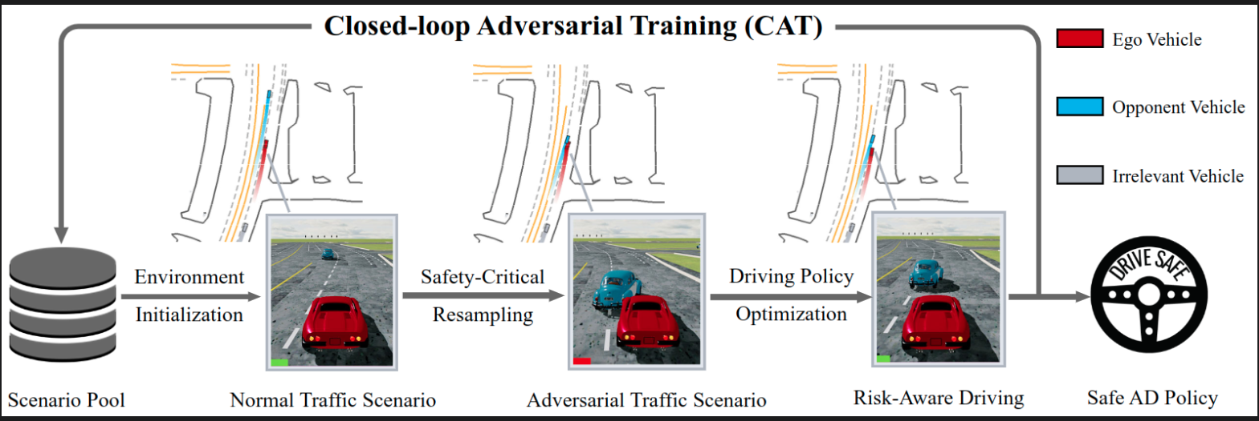
Overview of the proposed method.

Slide 15
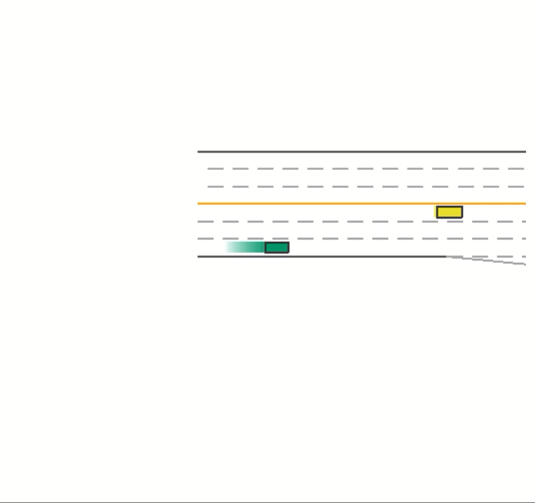
Metadrive Environment
This code sets up and runs a simulation using the MetaDrive environment, utilizing a pre-trained "expert" policy.

Slide 16
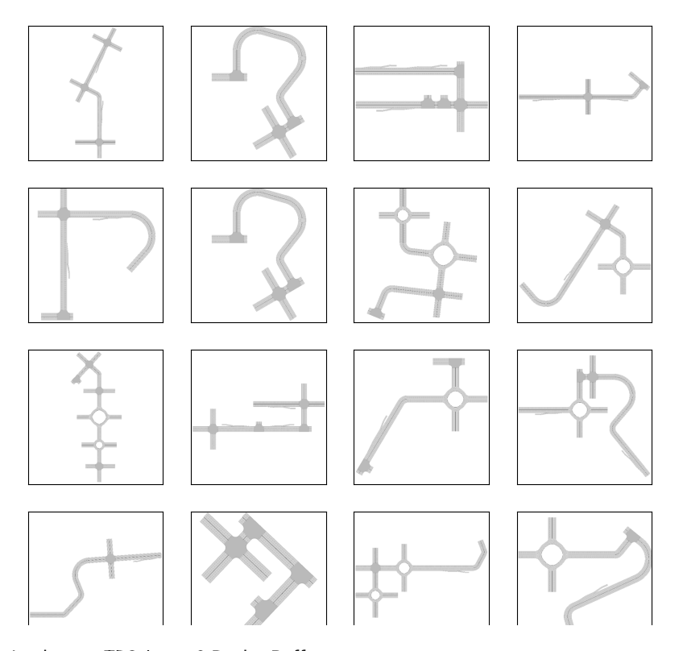
Top-down view of the maps

Slide 17
Learning Outcomes
TD3 Algorithm: You learn how TD3 addresses the limitations of Deep Deterministic Policy Gradient (DDPG) by using twin critics and delayed policy updates to improve stability.
Experience Replay: You see the benefits of storing and reusing past experiences to enhance learning efficiency and reduce correlations between samples.
Practical Implementation: The code provides a concrete example of how to implement a TD3 agent with a replay buffer using the stable_baselines3 library.
Evaluation and Visualization: You get to see how to assess the agent's performance by running evaluation episodes and plotting the rewards, helping you understand how well the agent has learned to navigate the environment.

Slide 18
Future work
Hyper-parameter Optimization: Fine-tuning hyper-parameters using techniques like grid search or Bayesian optimization could further improve performance.
Save reward/cost plots
TensorBoard Logging: to track various metrics during training, such as loss, exploration, and more.

Slide 19
Thank You

